Slide 1
BANANA DATASET ANALYSIS
Baran KALECİKLİ 21290219

Slide 2
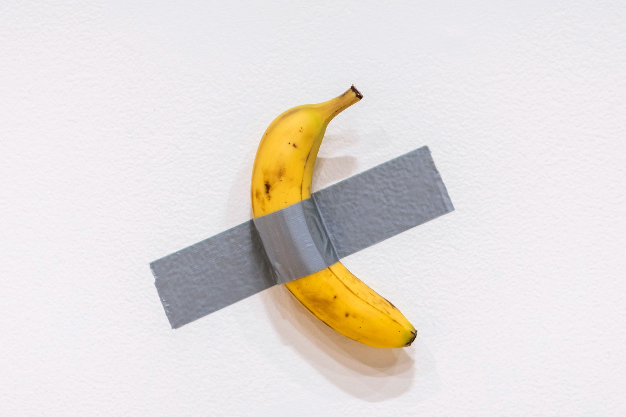
The Purpose of The Analysis
The aim of this data analysis is to measure the relationships between features of bananas using the samples taken and to draw conclusions.

Slide 3
Features of Bananas
sample_id
variety
region
quality_score
quality_category
ripeness_index
ripeness_category
sugar_context_brix
firmness_kgf
length_cm

Slide 4


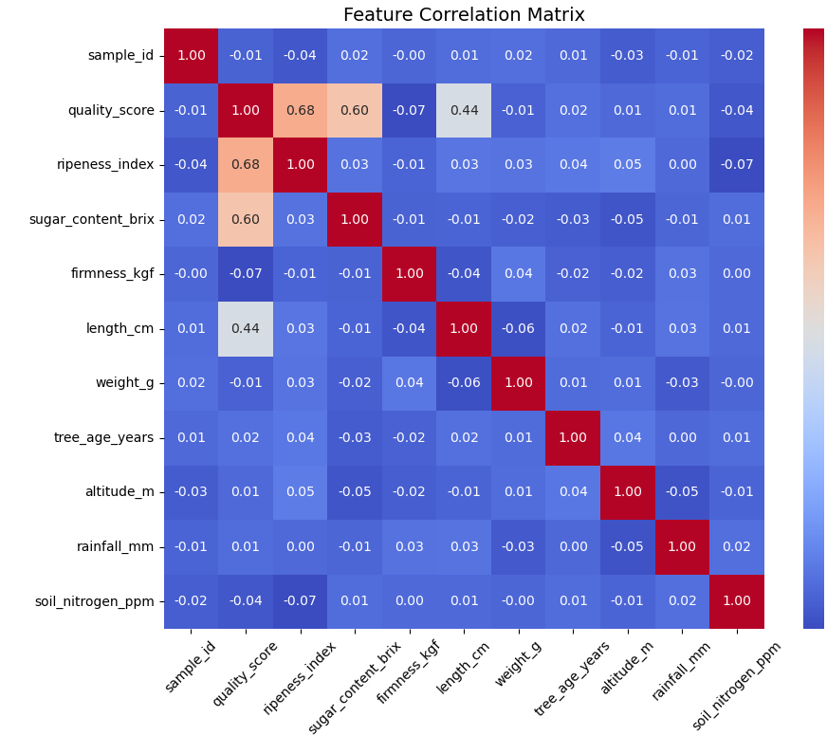

One of the easiest ways to observe the relationship between features is to create a correlation map.
The correlation value is in between -1 and 1.
If two of the features have direct correlation, the correlation value is close to 1.
If they have inverse correlation, the values is close to -1.
If there is no relation, the value is close to 0.

Slide 5
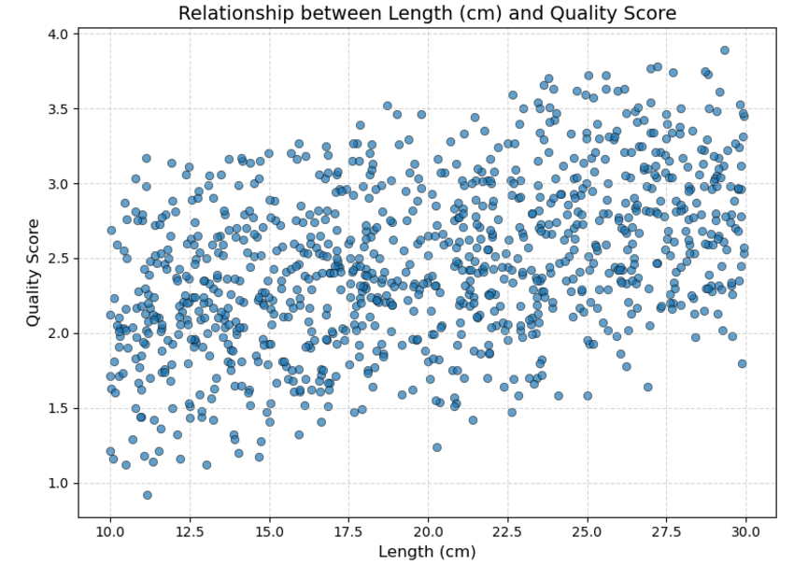
The correlation value between length and quality score is 0.44.
In order to have sufficient correlation, the correlation value have to be bigger than 0.70.

Slide 6
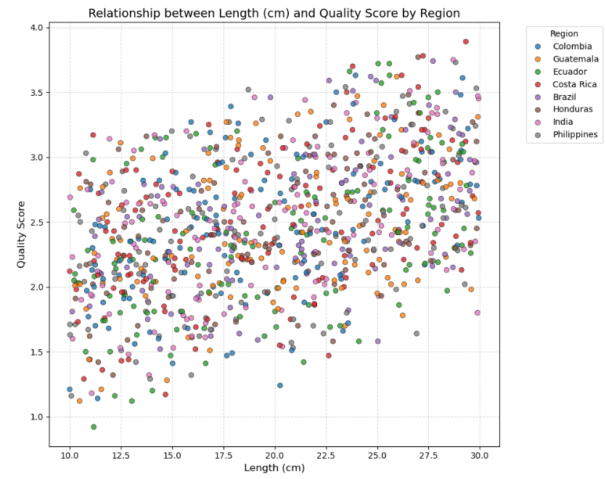
As shown in the figure, there is no close reletion between any relation and lenth or quality score.

Slide 7
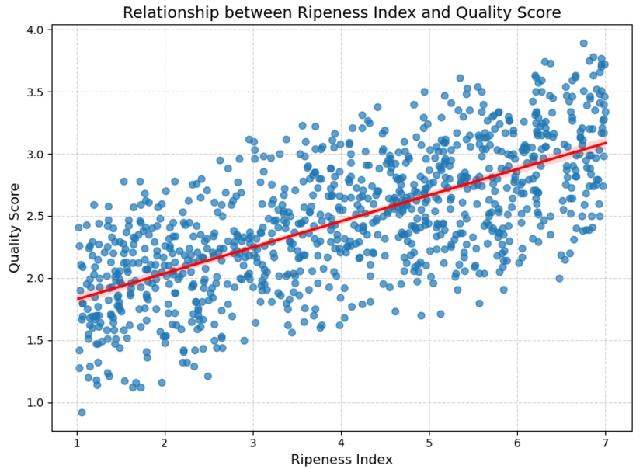
The correlation value between ripeness index and quality score is 0.68.

Slide 8
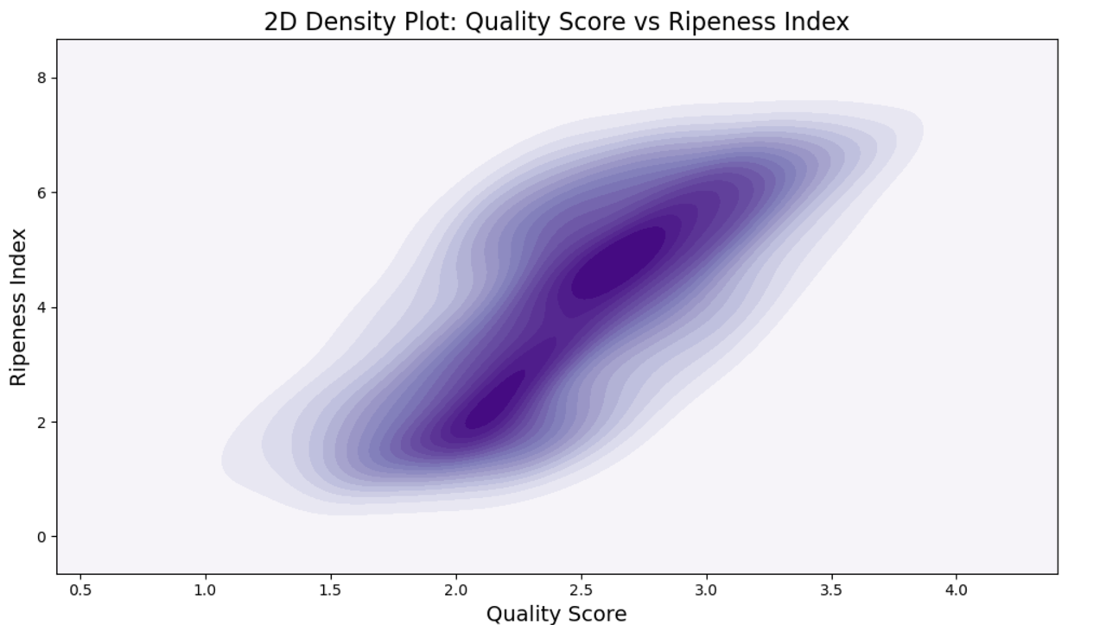
2D Density Plot of quality score vs ripeness index.

Slide 9
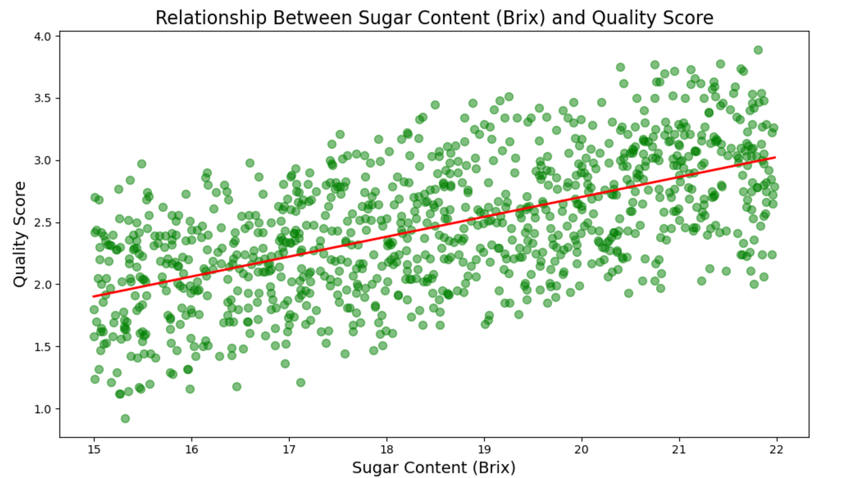
The correlation value between sugar content (brix) and quality score is 0.60.

Slide 10
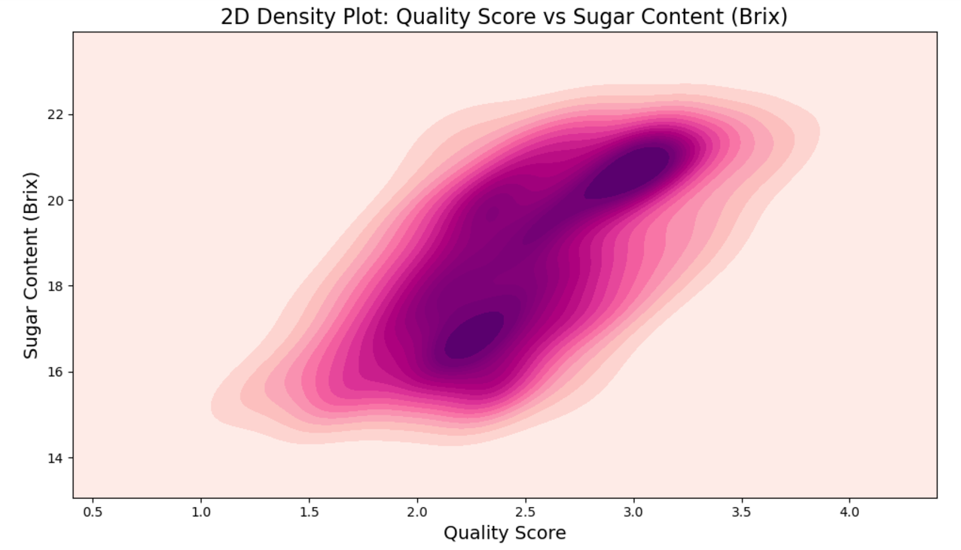
2D Density Plot of quality score vs sugar content (brix).

Slide 11
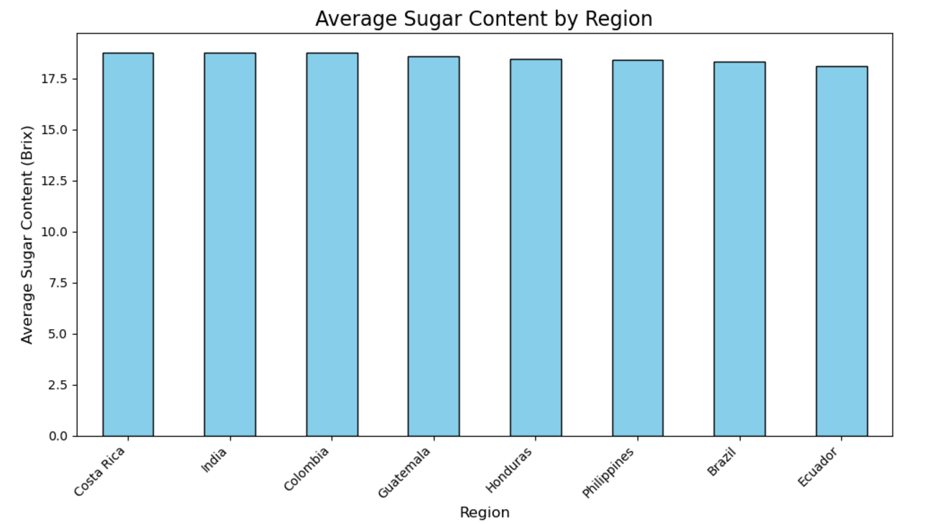
The graph of average sugar content by region in descending order.
As seen in the figure, there is no relation between sugar content and geographical location.

Slide 12
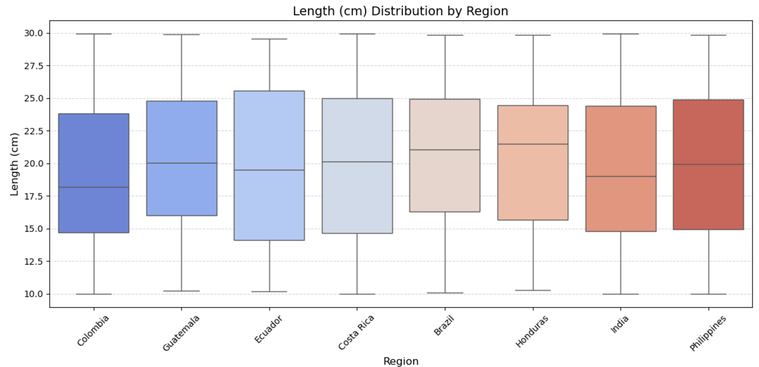
The figure shows the distribution of banana lengths and min-max values.

Slide 13
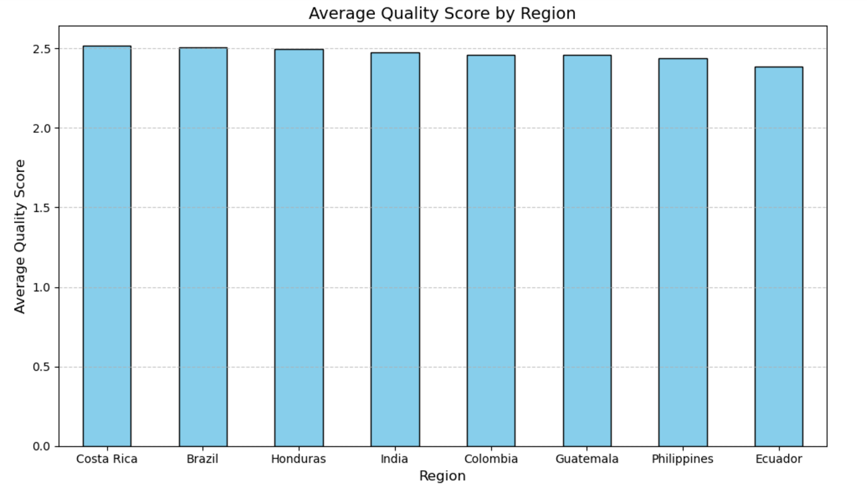
The figure shows the quality score and region relation.

Slide 14
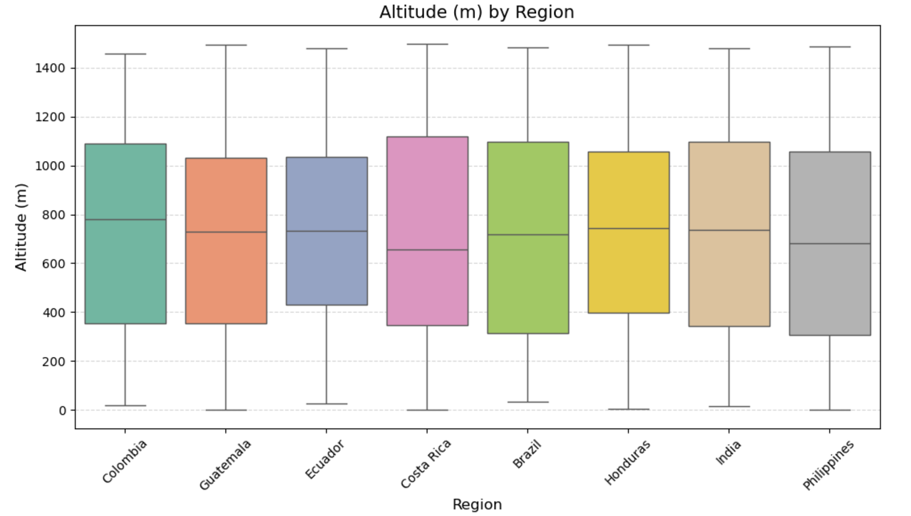
The relation between altitude and region is shown in boxplot graph.

Slide 15
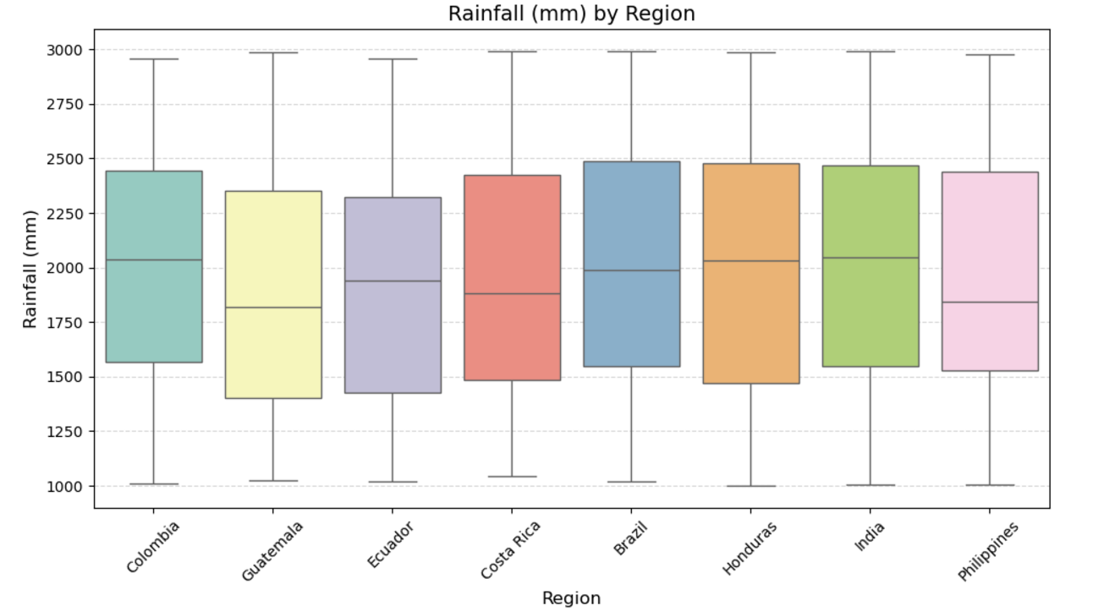
The relation between rainfall and region.

Slide 16
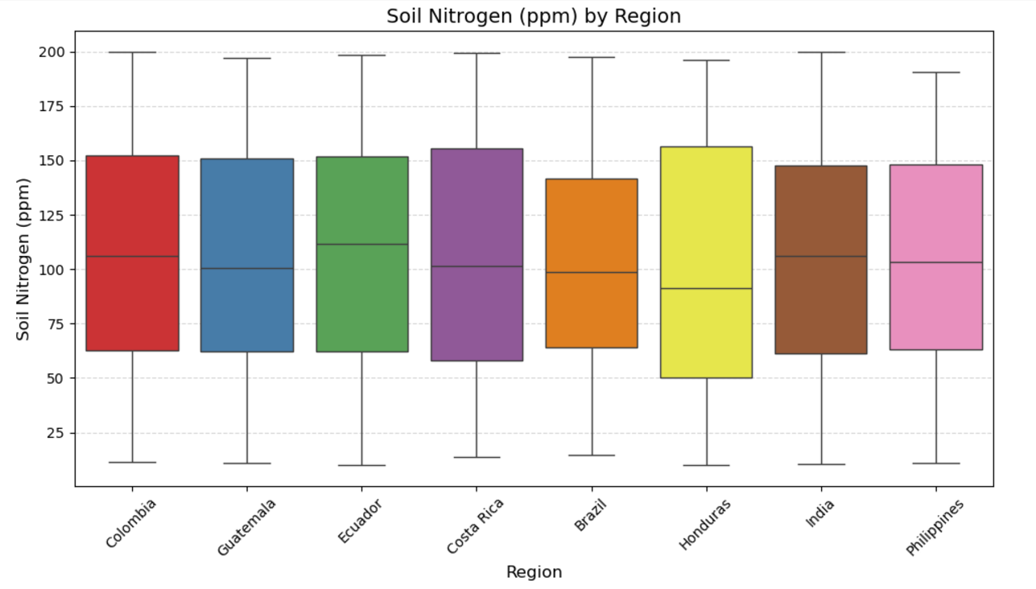
The relation between soil nitrogen (ppm) by region.

Slide 17
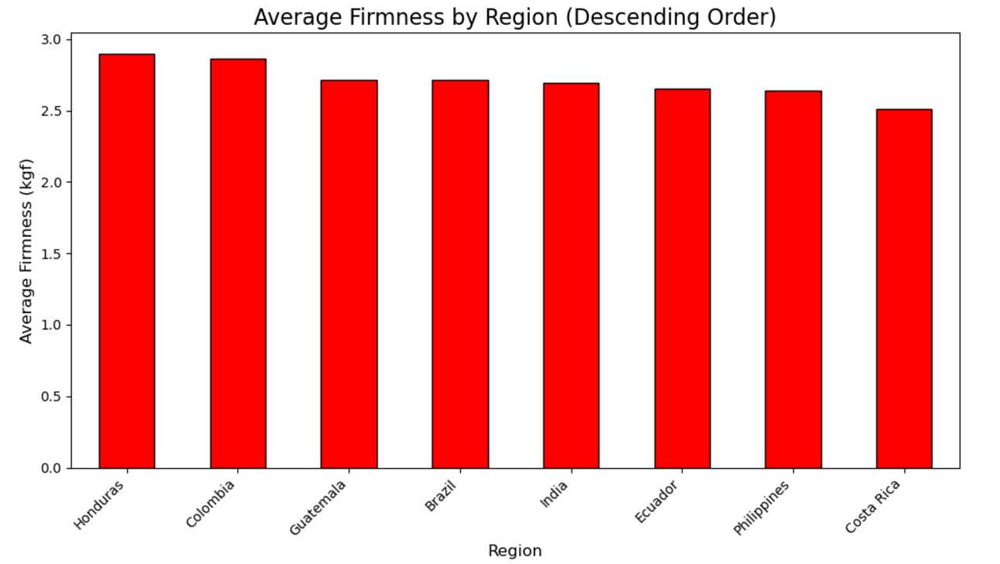
The relation between firmness and region.

Slide 18
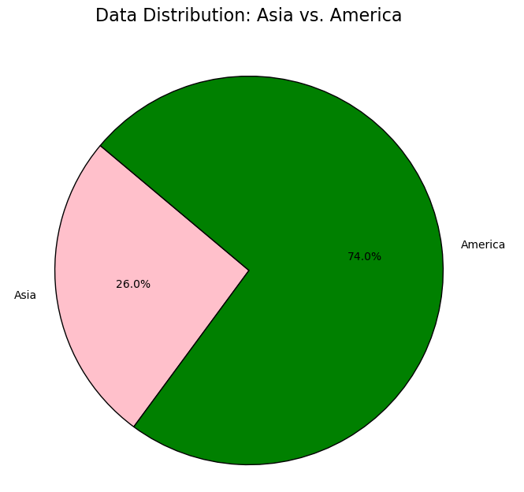
The graph shows the ratio of number of bananas and their continent.

Slide 19
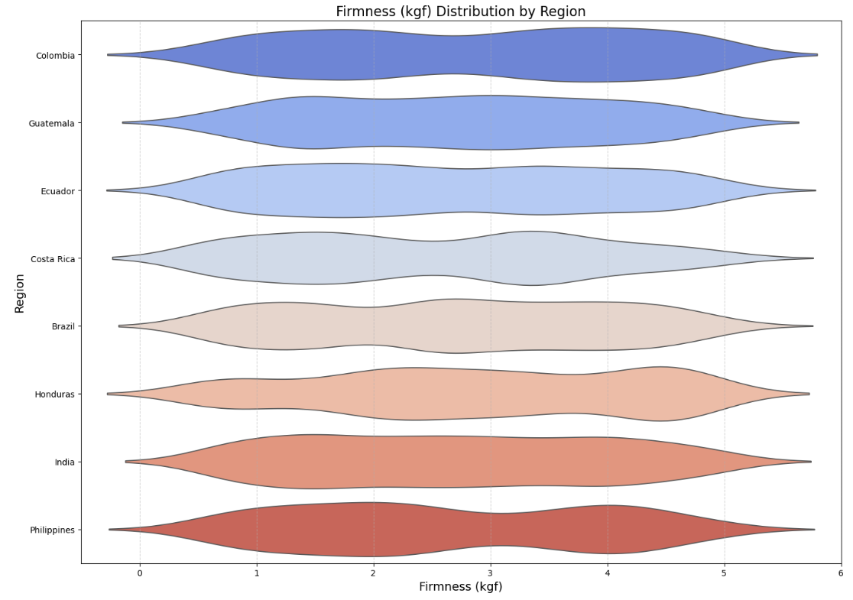
The violin plot graph shows the firmness(kgf) and region relation.

Slide 20
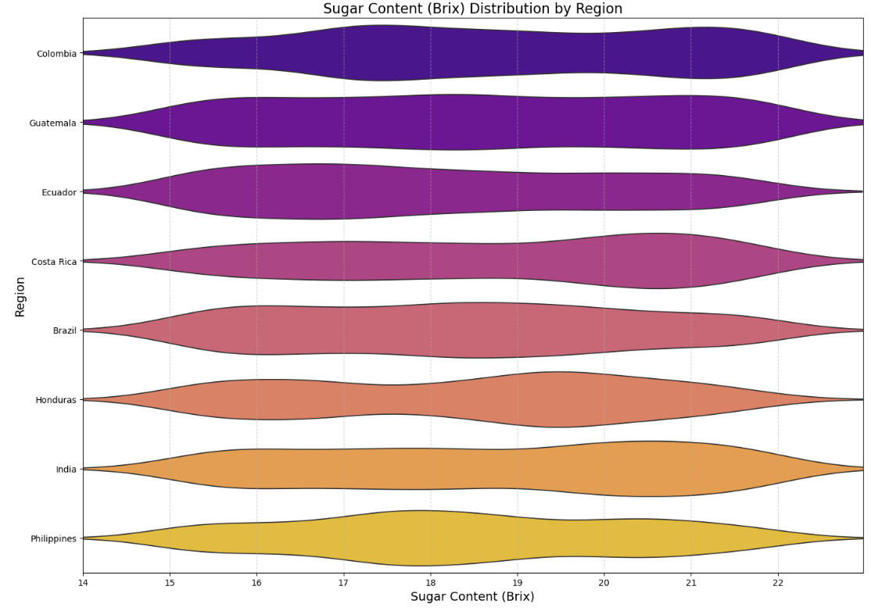
The graph shows sugar content(brix) distribution by region.
The violin graph and boxplot serve similar purposes.

Slide 21
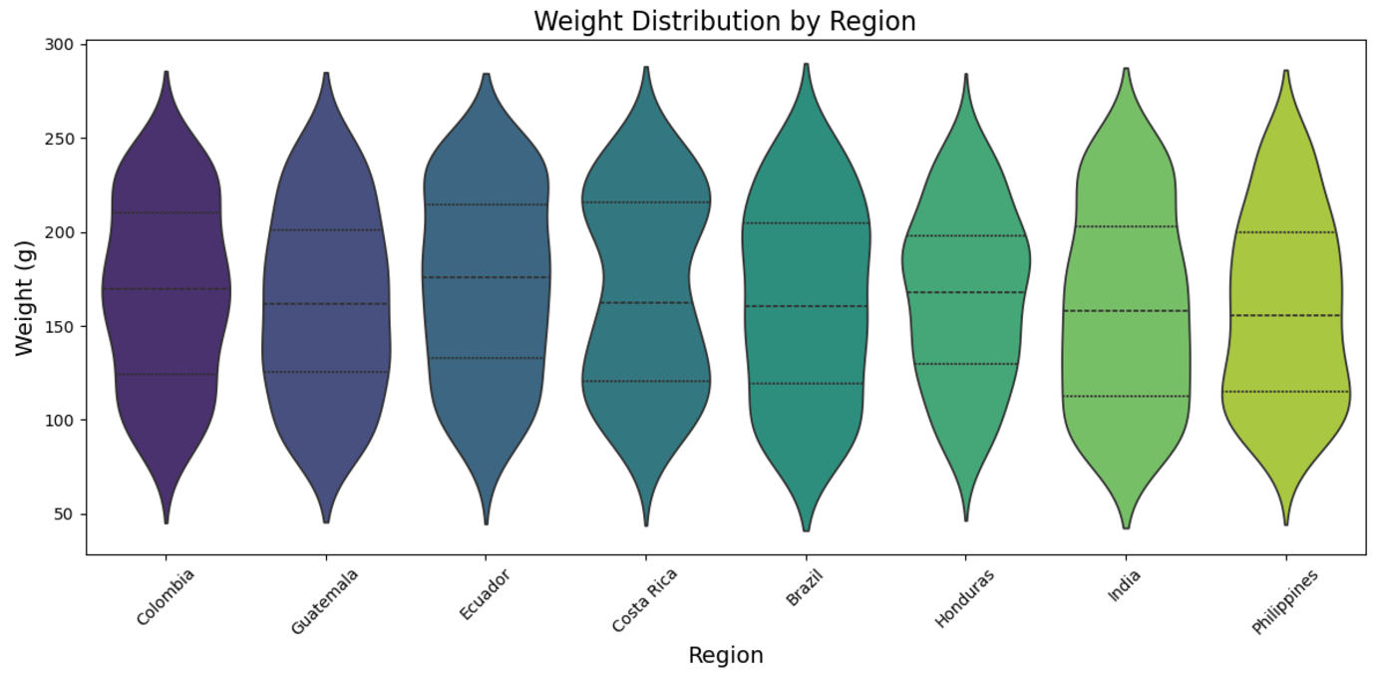
The relation between weight distribution and region.

Slide 22
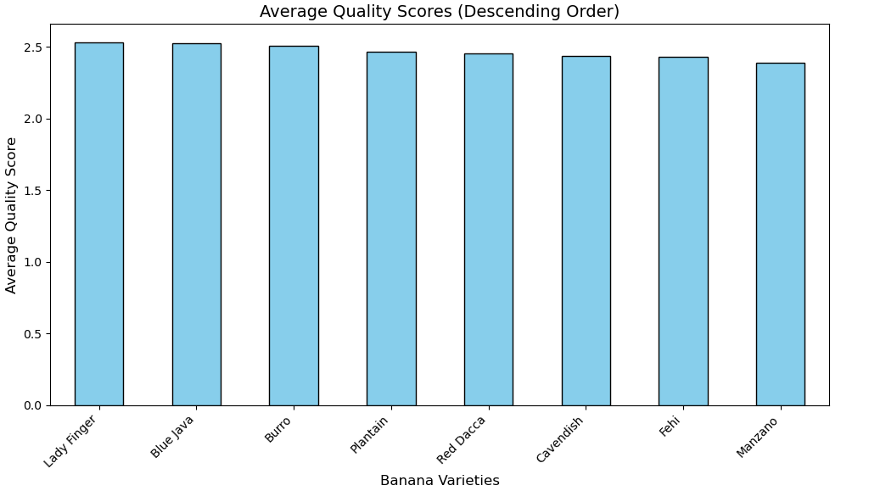
The relation between average quality scores and banana varieties.

Slide 23
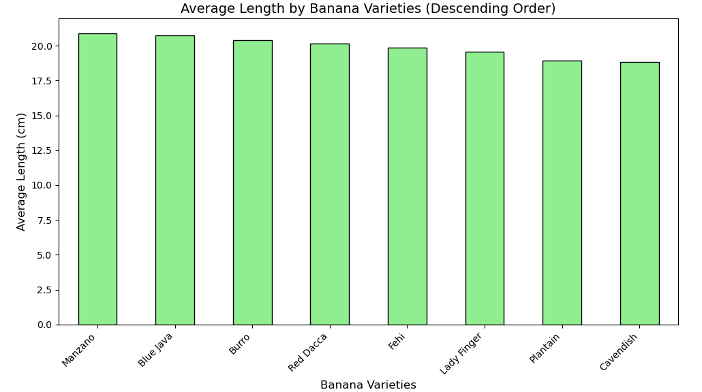
The relation between length of bananas and their varieties.

Slide 24
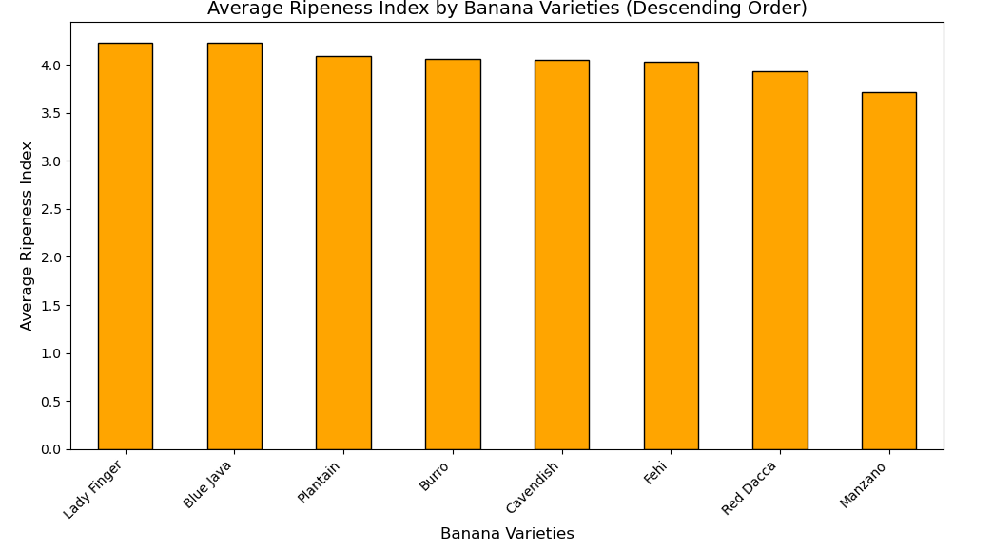
The relation between ripeness index and varieties.

Slide 25
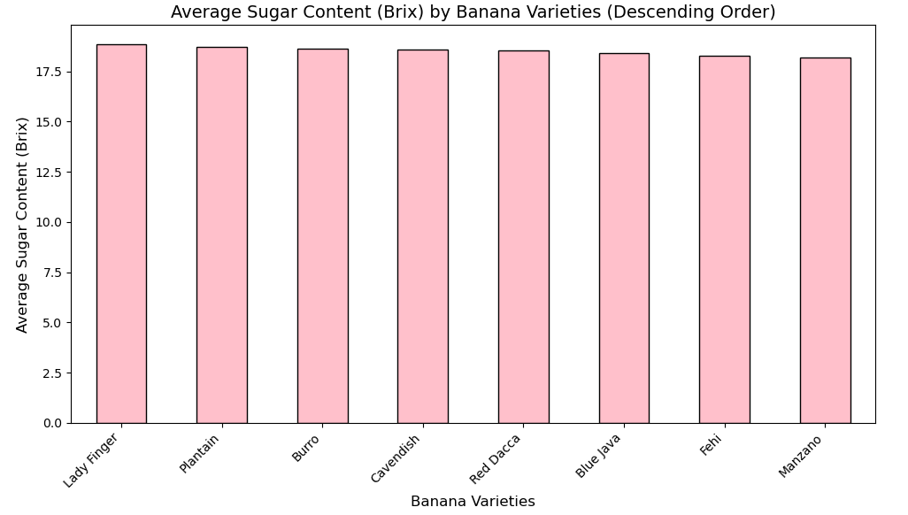
The relation between sugar content (brix) and varieties.

Slide 26
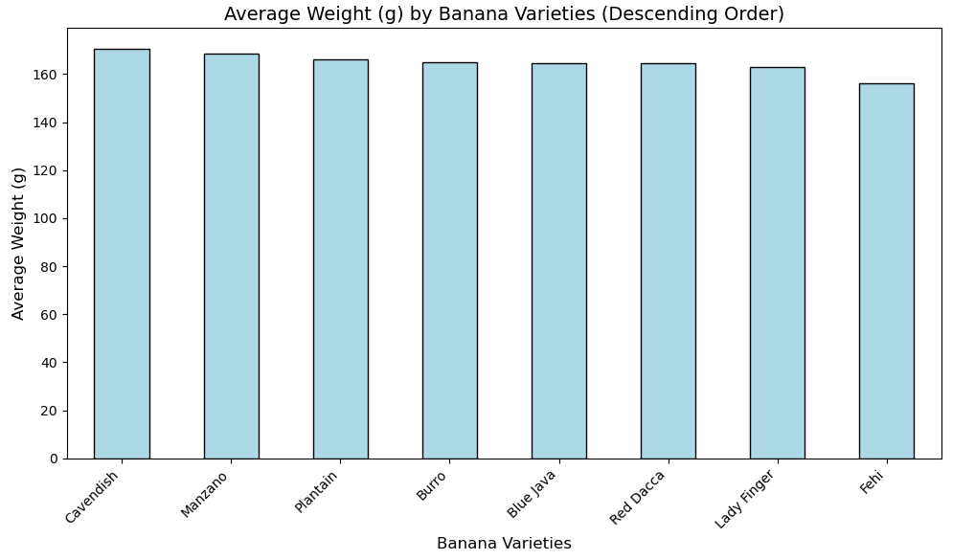
The relation between average weight (g) and varieties.

Slide 27
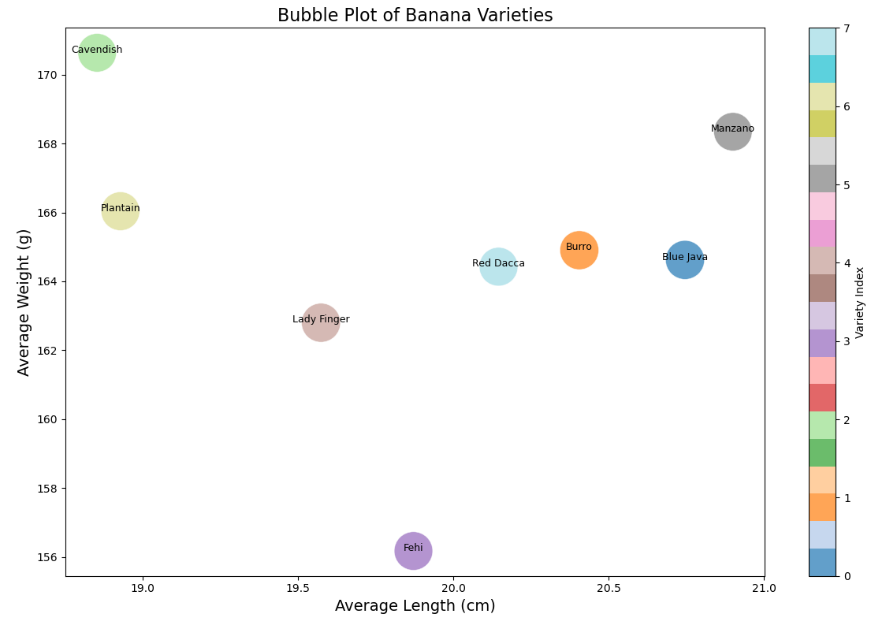
Bubble plot:

Slide 28
THANK YOU FOR YOUR TIME

